Slide 1
Project 3
Integrate Grafana with Linux Server for high cpu utilization and create a graph in Grafana.
Presented by krati pandey

Slide 2
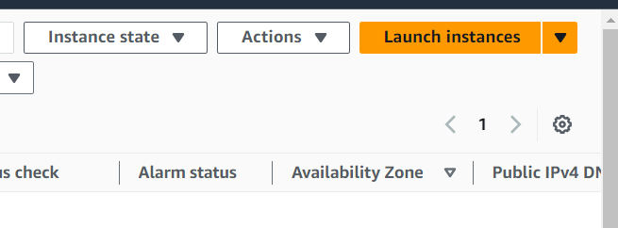
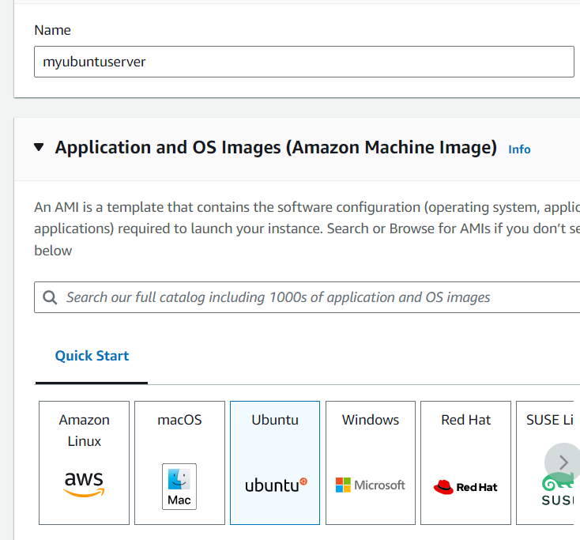
Step 1: Sign to the AWS console select region Asia Pacific(Mumbai) ap-south-1
Go to the EC2.
Step 2: Select instance & launch an instance.
Step 3:Enter your instance name & select ubuntu .

Slide 3
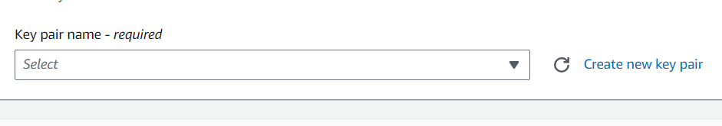
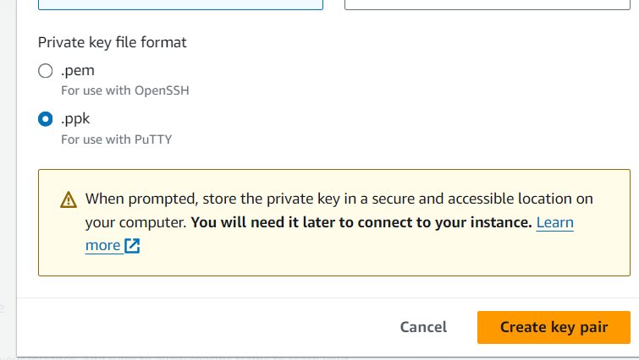
Step 4: Then select create a new keypair .
Step 5: Enter keypair name & select . ppk then click on create key pair.

Slide 4
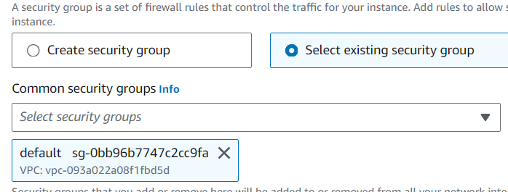
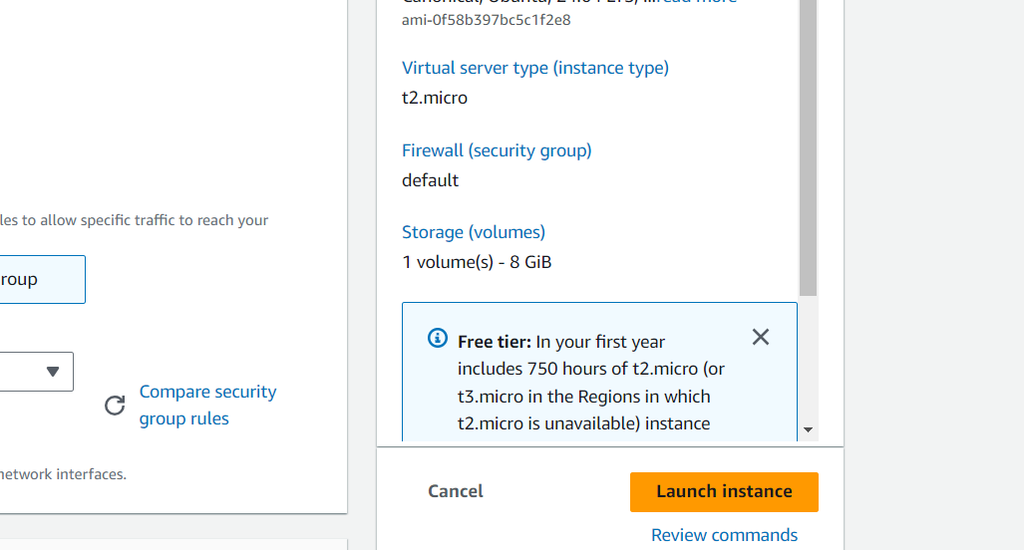
Step 6: Then select existing security group default .click on launch instance.

